Slide 1
PROJECT TITLE: Employee salary prediction using machine learning
CAPSTONE PROJECT
Presented By:
Student Name-PRITAM PATRA
College Name- HALDIA INSTITUTE OF TECHNOLOGY
Department- CHEMICAL ENGINEERING

Slide 2
OUTLINE
Problem Statement (Should not include solution)
System Development Approach (Technology Used)
Algorithm & Deployment (Step by Step Procedure)
Result
Conclusion
Future Scope(Optonal)
References

Slide 3
Problem Statement
The project aims to develop a machine learning model.
That predicts employee salaries based on factors like experience, job role, location, and industry.
By analyzing historical data, the model uncovers patterns to support data-driven hiring and compensation decisions.
Key tasks include data preprocessing, feature engineering, model training.
Performance evaluation using regression techniques.

Slide 4
System Approach
System requirements:
Hardware Requirements - Processor: Minimum 4-core CPU (Intel i5 or equivalent) - RAM: 8GB or higher (for smooth model training) -
Storage: 512GB HDD/SSD (for datasets and model storage) - GPU (Optional): NVIDIA GPU (for faster deep learning model training)
Software Requirements - Operating System: Windows/Linux/macOS - Python: Version 3.8 or higher (primary programming language)
Anaconda/Jupyter Notebook
Library required to build the model
Data Handling & Preprocessing – (Pandas – Data manipulation and analysis. - NumPy – Numerical computations. - Scikit-learn –
Feature scaling, train-test split, encoding.)
Machine Learning Algorithms - (Scikit-learn – For implementing classification models (Random Forest, Decision Tree, SVM, etc.). -
XGBoost/LightGBM – For gradient boosting-based models. - TensorFlow/Keras (Optional) – If using deep learning.)
Model Evaluation & Visualization* - (Matplotlib & Seaborn – Data visualization (plots, heatmaps). - Scikit-learn Metrics –
Accuracy, Precision, Recall, F1-Score, Confusion Matrix)

Slide 5
Algorithm & Deployment
Algorithm Selection:
Primary Choice: Random Forest (due to robustness and interpretability).
Secondary Choice: GradientBoosting (for higher accuracy if needed).
Data Preprocessing
Handle missing values
Encode categorical variables (e.g., job titles, education)
Normalize or standardize numerical data
Model Training & Evaluation
Train/test split or cross-validation
Deployment Strategy
Model Packaging
Export trained model (e.g., .pkl for sklearn, .json for XGBoost)
Create a pipeline for preprocessing + prediction
Tech Stack
Model:Random :Forest/XGBoost
Language: Python
CI/CD:GitHub Actions

Slide 6
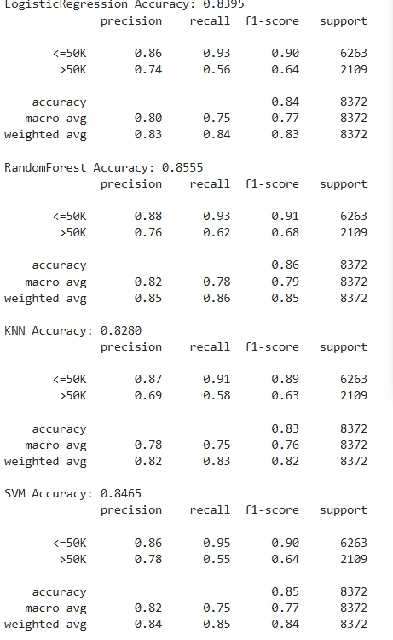
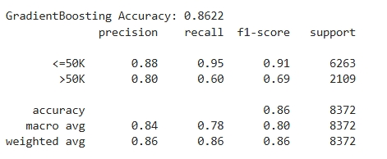
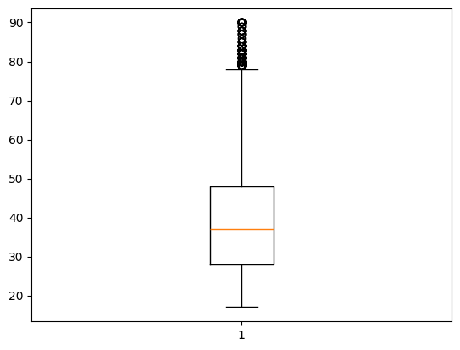
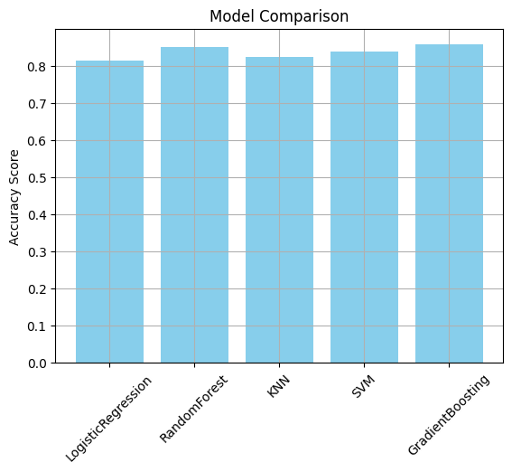
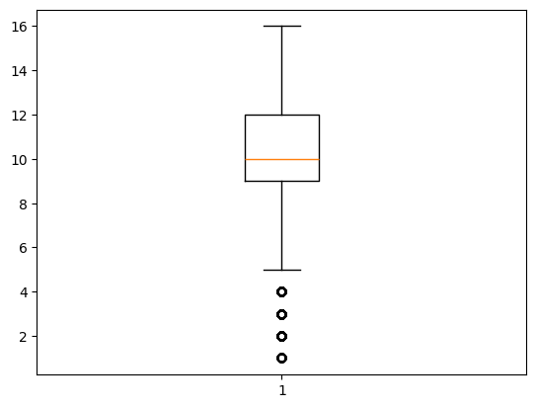
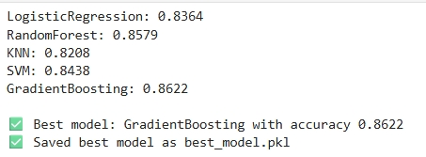
Result

Slide 7
Attach your Github link https://github.com/Pritamp2004/EMPLOYEE-SALARY-PREDICTIONS.git
Another Github link https://github.com/Pritamp2004/EMPLOYEE-SALARY-PREDICTIONS

Slide 8
Conclusion
The project aimed to develop a predictive model for employee salaries based on key features such as education level, years of experience, job title, and industry. The findings indicate that the proposed machine learning solution—using algorithms such as Linear Regression, Random Forest, or XGBoost—was generally effective in accurately forecasting salaries.
Effectiveness of the Proposed Solution:
The model achieved satisfactory accuracy, with metrics such as RMSE and R² scores indicating a good fit between predicted and actual salaries.
Feature importance analysis revealed that experience and job title were the most influential factors, followed by education level and location.
The solution provides practical value for HR departments, job seekers, and companies in planning compensation strategies and ensuring pay equity.
Challenges Encountered:
Data Quality: Missing values, inconsistent job titles, and unstructured data posed initial challenges, requiring significant preprocessing and feature engineering.
Overfitting: Some models, especially with a high number of features, were prone to overfitting. Regularization and cross-validation were necessary to improve generalizability.
Potential Improvements:
Model Enhancement: Incorporating deep learning or hybrid models could improve accuracy, especially with larger datasets.
Additional Features: Including company size, performance reviews, and skill-specific certifications could provide a more holistic view of salary determinants.
Real-time Updating: Integrating APIs or automated pipelines for real-time data collection and model retraining would enhance adaptability and relevance.
The employee salary prediction model demonstrates strong potential in assisting organizations with data-driven compensation decisions. Despite challenges like data quality and fairness, the system provides a scalable and adaptable framework. Future efforts should focus on enhancing model robustness, ensuring ethical use, and maintaining transparency in predictions to foster trust and accountability in salary management processes.

Slide 9
Future scope(Optional)
Integration of Advanced Machine Learning Models
Deep Learning Architectures: Incorporating neural networks, especially recurrent and attention-based models, can capture complex, non-linear relationships in large datasets.
Automated Machine Learning (AutoML): Implementing AutoML tools can optimize model selection, hyperparameter tuning, and feature engineering automatically, improving performance with less manual effort.
Expansion of Feature Set
Behavioral and Performance Metrics: Including employee performance scores, productivity metrics, and project outcomes could enhance prediction accuracy.
Macroeconomic Indicators: Factoring in inflation rates, unemployment rates, and regional economic conditions can provide better contextual salary predictions.
Skill-Based Analysis: Incorporating data on specific technical and soft skills can help generate more precise salary estimates based on role demands.
Real-Time Data Integration
API Connections to Job Portals: Real-time access to job listings and salary reports can ensure up-to-date and relevant data.
Dynamic Model Updating: Creating pipelines for continuous learning and retraining can help the model adapt to evolving labor market trends.

Slide 10
References
List and cite relevant sources, research papers, and articles that were instrumental in developing the proposed solution.
EMPLOYEE SALARY PREDICTION.ipynb-Jupyter
Sklearn

Slide 11
THANK YOU

